Slide 1
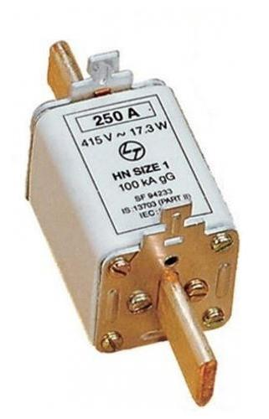
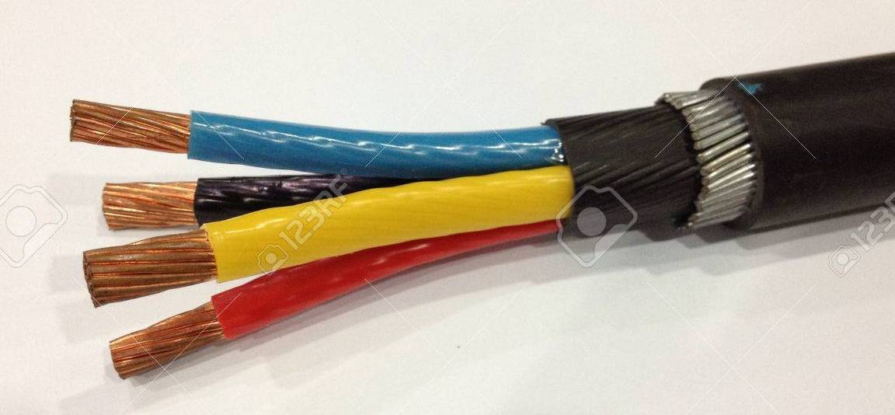
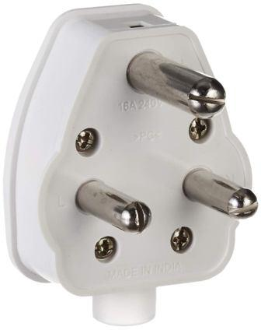
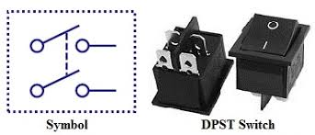
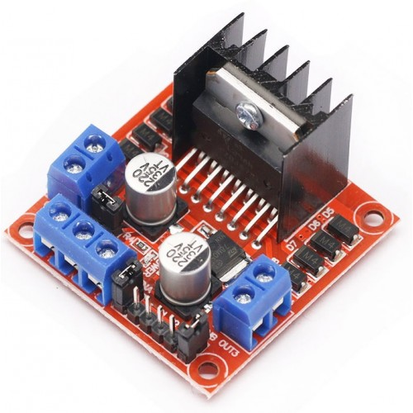
Cu Conductors PVC insulation Bedding GI Armouring
RME Lab – 2
Electrical Components
FY – DESH – VIT
Serving
Colour codes and Insulation levels in a Power Cable
Vishwakarma Institute of Technology
FY - Department of Engineering, Sciences and Humanities

Slide 2
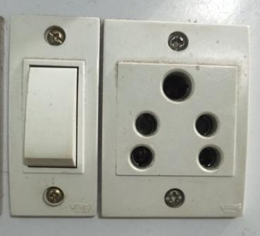
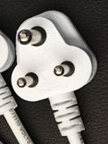
Vishwakarma Institute of Technology
FY - Department of Engineering, Sciences and Humanities
Piano Switch Single Phase Socket Single Phase Pin

Slide 3
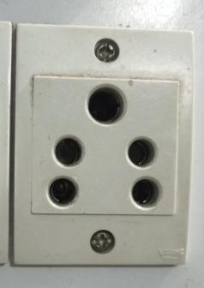
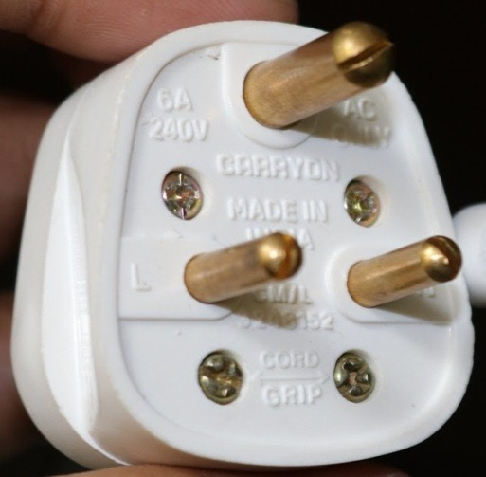
Earth
(Top)
Earth
(Top)
Phase
(Right)
Phase
(Left)
Vishwakarma Institute of Technology
Neutral
(Left)
FY - Department of Engineering, Sciences and Humanities
Neutral
(Right)
Standard conventions for Phase, Neutral and Earth in a socket
What about a Pin ?

Slide 4
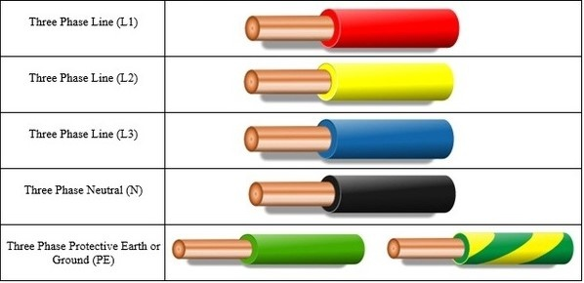
Phase 1 - Red
------------------------
Phase 2 - Yellow
------------------------
Phase 3 - Blue
------------------------
Neutral - Black
------------------------
Earth or Ground –
Green / Green + Yellow
Vishwakarma Institute of Technology
FY - Department of Engineering, Sciences and Humanities
Colour Code in Power Cables

Slide 5
Cu Conductors PVC insulation Bedding GI Armouring
Serving
Vishwakarma Institute of Technology
FY - Department of Engineering, Sciences and Humanities
Colour codes and Insulation levels in a Power Cable

Slide 6
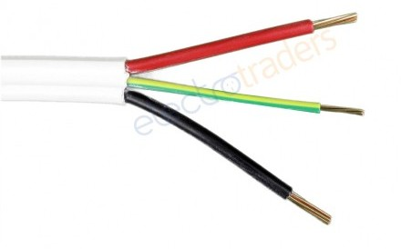
3 ?
NO !
How many phases are in this Cable ?
Vishwakarma Institute of Technology
FY - Department of Engineering, Sciences and Humanities
This is a Single Phase , 3 Core Cable
Red – Green – Black
Phase – Earth – Neutral

Slide 7
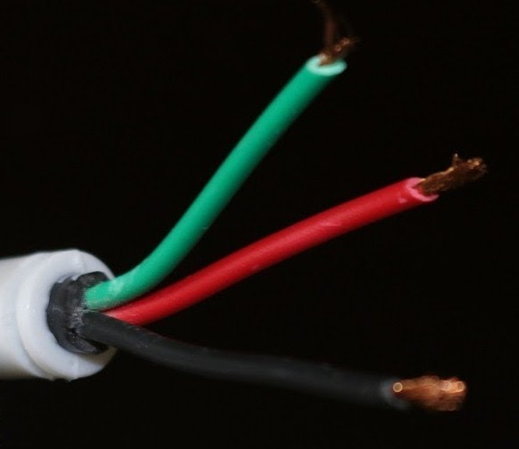
?
?
?
1
2 3
Vishwakarma Institute of Technology
FY - Department of Engineering, Sciences and Humanities
Where the 3 wires would be connected to ?
Green – Red – Black

Slide 8
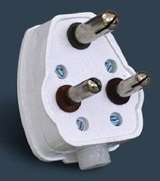
Observe this image carefully
Vishwakarma Institute of Technology
FY - Department of Engineering, Sciences and Humanities
The Length and Diameter of Earth Pin is larger than the other two !
Why there is a slot at the tip of the pin ?

Slide 9
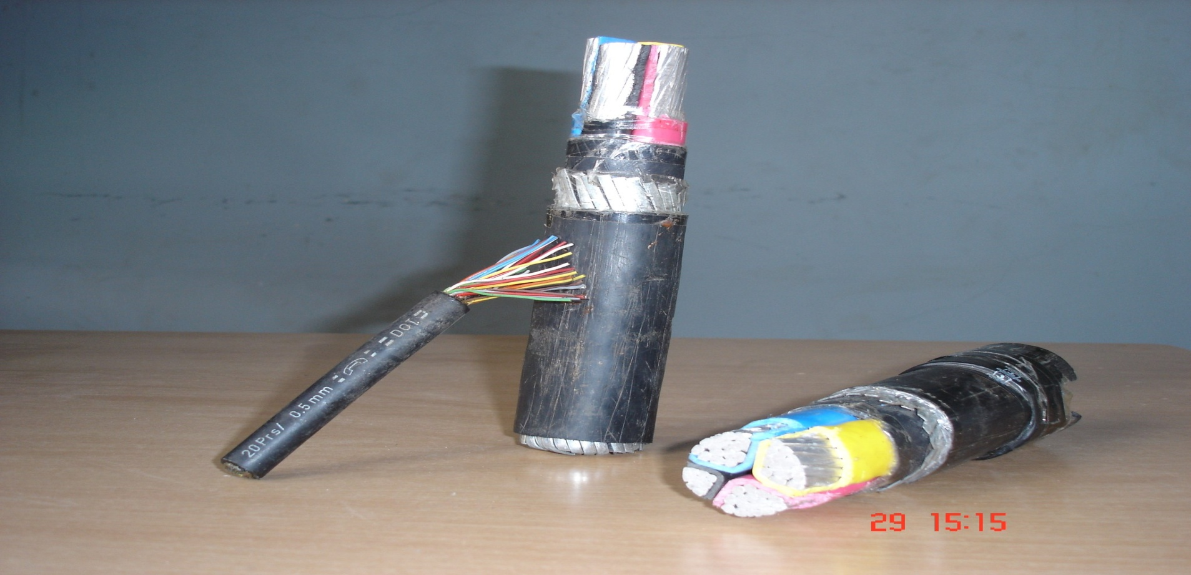
Vishwakarma Institute of Technology
FY - Department of Engineering, Sciences and Humanities
Control Cables and Power Cables

Slide 10


Electric Cable contd…...
Cross Section of an Electric Cable
3 Core Cable
4 Core Cable
3.5 Core Cable
Vishwakarma Institute of Technology
FY - Department of Engineering, Sciences and Humanities

Slide 11
Lugs are used connect two cables.
Vishwakarma Institute of Technology
FY - Department of Engineering, Sciences and Humanities

Slide 12
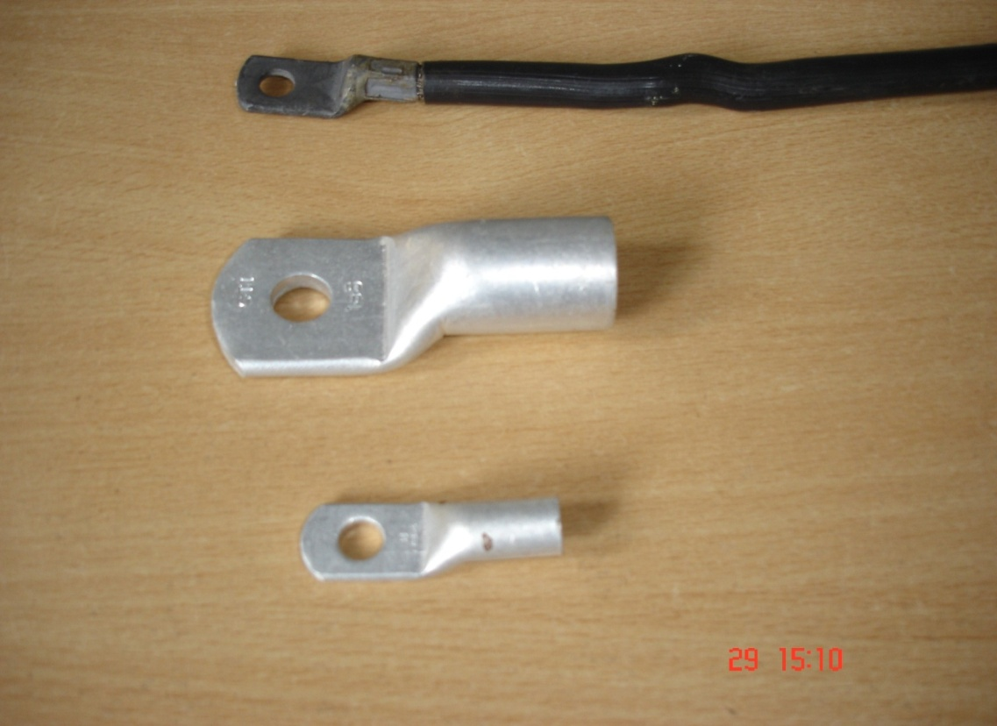
Vishwakarma Institute of Technology
FY - Department of Engineering, Sciences and Humanities
Lugs

Slide 13
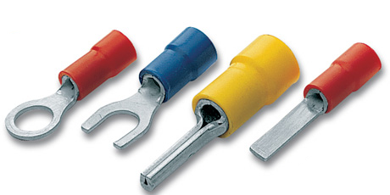

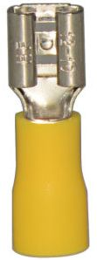
Different types of Lugs
Vishwakarma Institute of Technology
FY - Department of Engineering, Sciences and Humanities
Hole type Lug
‘U’ type Fork Lug
Terminal Lug
Pin type Lug

Slide 14
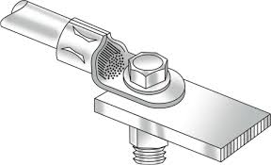
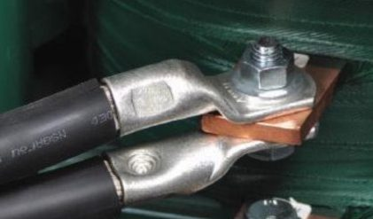
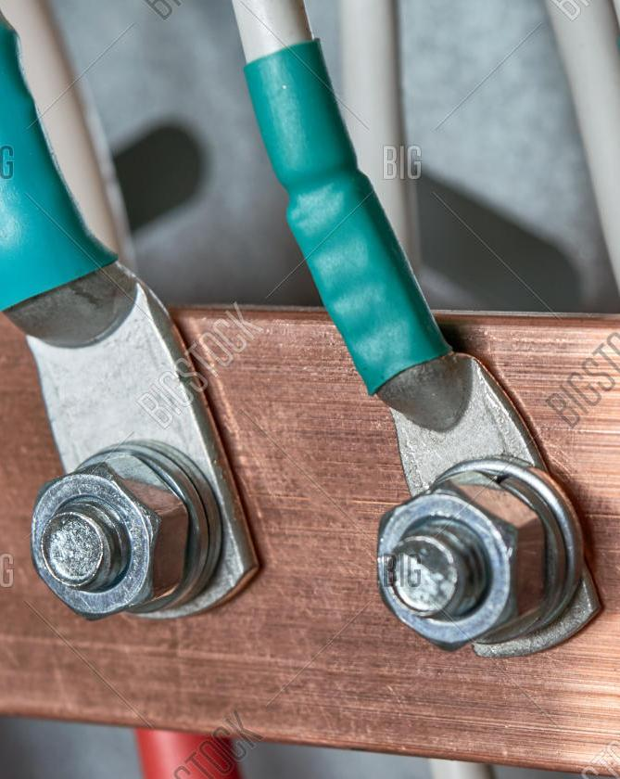
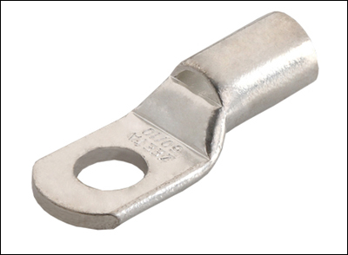
Use of Lugs for connection of Cable
Vishwakarma Institute of Technology
FY - Department of Engineering, Sciences and Humanities
Material – Copper or Aluminum

Slide 15
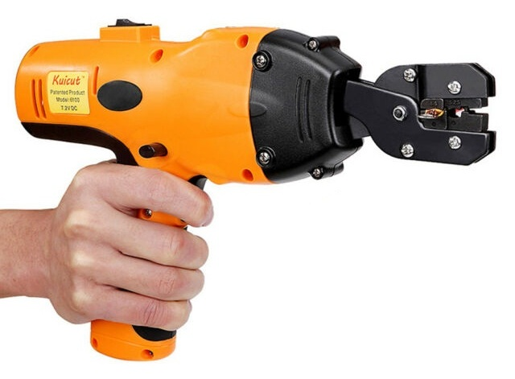
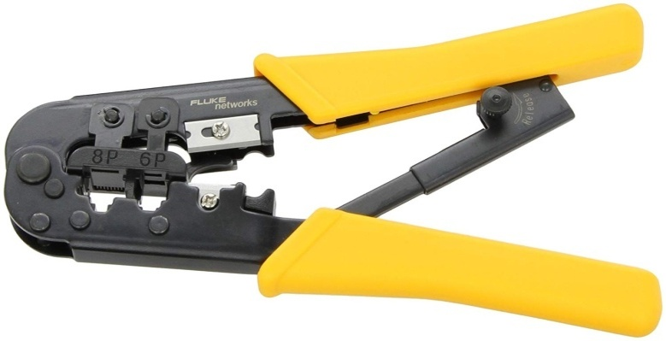
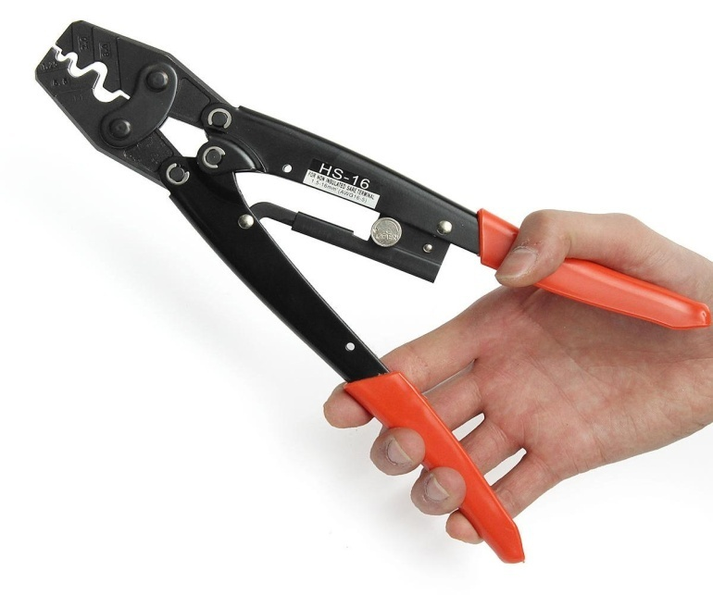
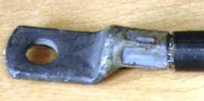
Lug Crimping Tools
Vishwakarma Institute of Technology
FY - Department of Engineering, Sciences and Humanities

Slide 16
EARTHING
ISI - 732 (1963)
The meaning of Earthing or Grounding means to connect the electrical equipment to the general mass of Earth by a wire of negligible resistance.
Vishwakarma Institute of Technology
FY - Department of Engineering, Sciences and Humanities
Purpose of Earthing is to ensure at all times an immediate discharge of electrical energy without danger.

Slide 17
Switch Fuse
Poor or Bad
Earthing
Phase
Current
passes through
the human
body
Vishwakarma Institute of Technology
FY - Department of Engineering, Sciences and Humanities
Neutral
Poor Earthing as R _{earth} >> R _{body}

Slide 18
Switch Fuse
Phase
Current passes
through the
Earth wire and
NOT through the human
body
Vishwakarma Institute of Technology
FY - Department of Engineering, Sciences and Humanities
Neutral
Good Earthing as R _{earth} << R _{body}

Slide 19
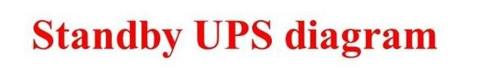
SUPPL
Y
LOAD
Charger
Battery
Inverter
Vishwakarma Institute of Technology
FY - Department of Engineering, Sciences and Humanities
SUPPL
Y
LOAD
Charger
Battery
Inverter

Slide 20
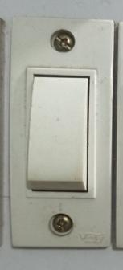
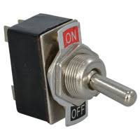
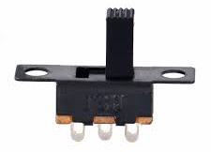
Toggle Switch
Vishwakarma Institute of Technology
FY - Department of Engineering, Sciences and Humanities
Piano Switch
Slide Switch

Slide 21
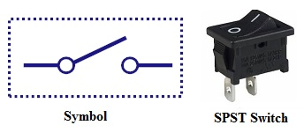
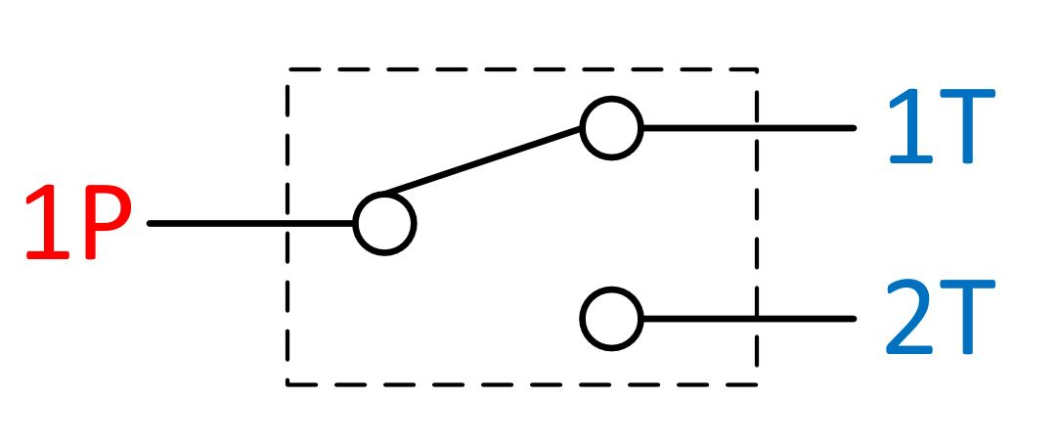
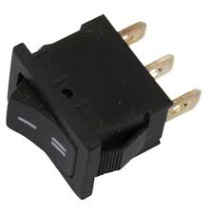
Vishwakarma Institute of Technology
FY - Department of Engineering, Sciences and Humanities
Symbol SPDT Switch

Slide 22
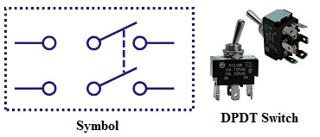
Vishwakarma Institute of Technology
FY - Department of Engineering, Sciences and Humanities

Slide 23
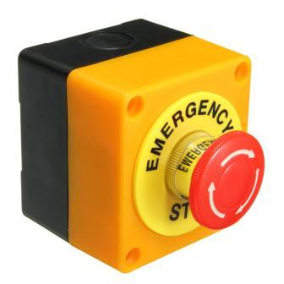
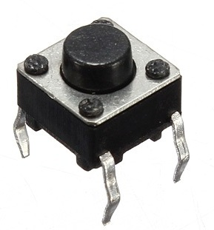
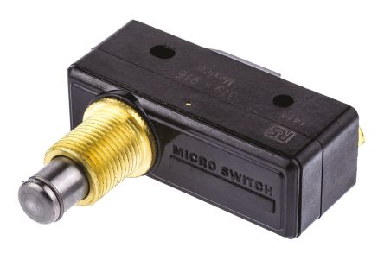
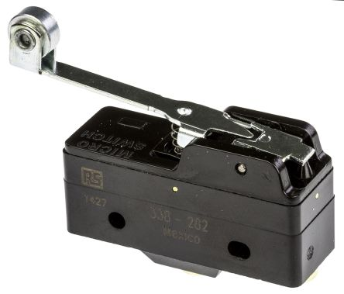
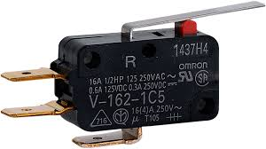
Push Button
Plunger type Switch
Emergency Switch
Vishwakarma Institute of Technology
FY - Department of Engineering, Sciences and Humanities
Roller type Switch
Hinge Lever type Switch

Slide 24
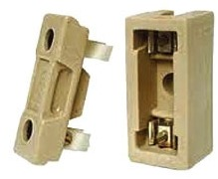
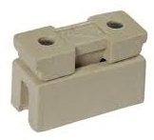
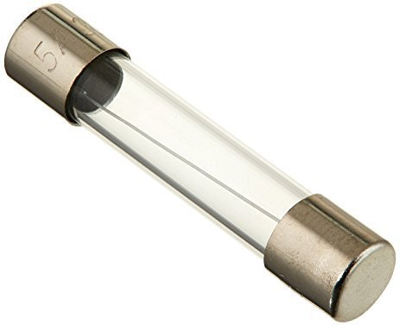
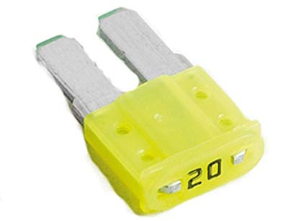
Kit Kat Fuse
(Rewirable Fuse)
Vishwakarma Institute of Technology
FY - Department of Engineering, Sciences and Humanities
Glass Fuse
Micro Blade type fuse

Slide 25
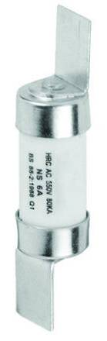
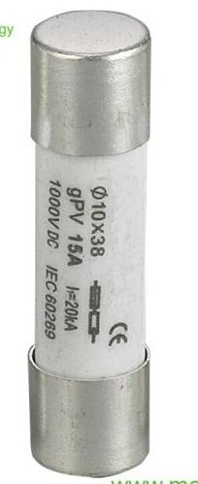
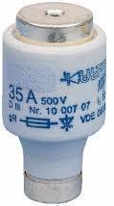
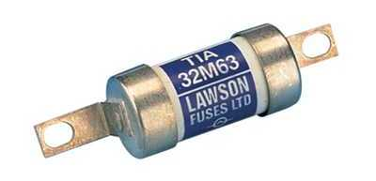
Vishwakarma Institute of Technology
FY - Department of Engineering, Sciences and Humanities
HRC (High Rupturing Capacity) Fuses

Slide 26
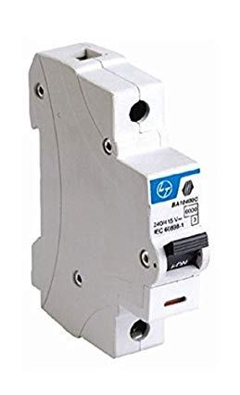
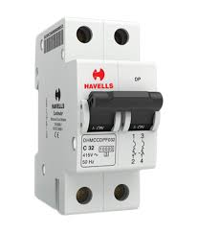
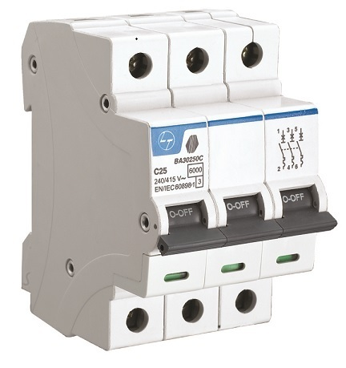
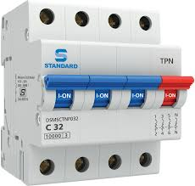

MCB –
Miniature
Circuit
Breaker
Vishwakarma Institute of Technology
FY - Department of Engineering, Sciences and Humanities
E.L.C.B.

Slide 27

Variable Contact
Rheostat Rating –
100 Ohm, 5 A
Fixed Contacts
Vishwakarma Institute of Technology
FY - Department of Engineering, Sciences and Humanities
Variable Contact
Fixed Contact 1
Fixed Contact 2

Slide 28


Actuators
Vishwakarma Institute of Technology
FY - Department of Engineering, Sciences and Humanities
DC Motor
AC Motor

Slide 29


Actuators contd..
Vishwakarma Institute of Technology
FY - Department of Engineering, Sciences and Humanities
Stepper Motor
Servo Motor

Slide 30


Actuators contd…
Vishwakarma Institute of Technology
FY - Department of Engineering, Sciences and Humanities
3 Phase AC Motor
BLDC Motor

Slide 31
Vishwakarma Institute of Technology
FY - Department of Engineering, Sciences and Humanities
Dual Channel Motor Driver Circuit

Slide 32


Vishwakarma Institute of Technology
FY - Department of Engineering, Sciences and Humanities
3 Phase AC Motor VFD
(Variable Frequency Drive)

Slide 33
Cu Conductors PVC insulation Bedding GI Armouring
RME Lab – 2
Electrical Components
Thanks !
FY – DESH – VIT
Serving
Colour codes and Insulation levels in a Power Cable
Vishwakarma Institute of Technology
FY - Department of Engineering, Sciences and Humanities

